Slide 1
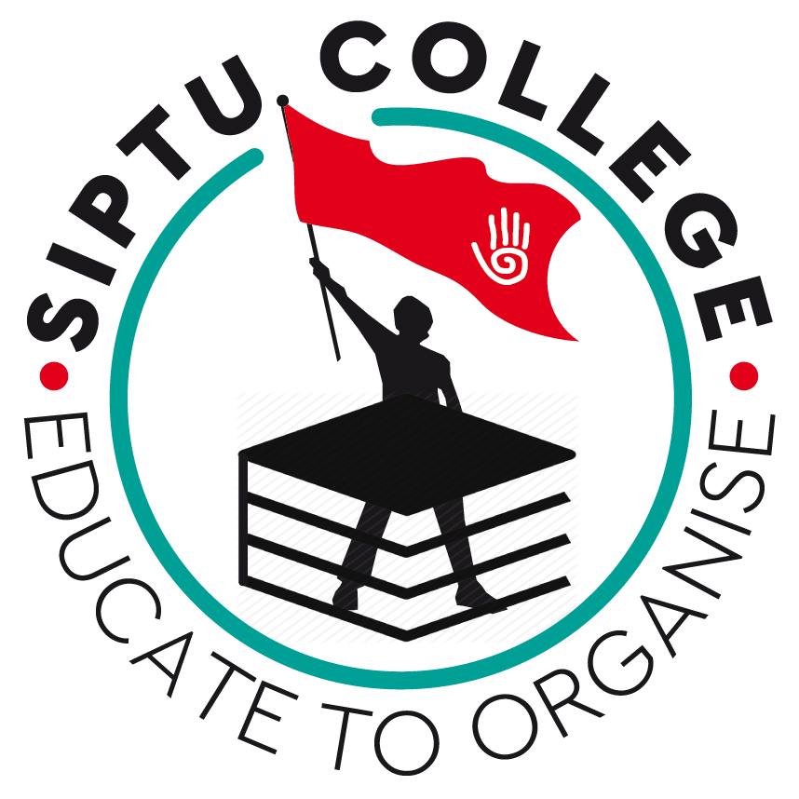
Strike, lock outs and
organised conflict

Slide 2
Review of last week:
How would you strengthen the right to collectively bargain
in Ireland?

Slide 3
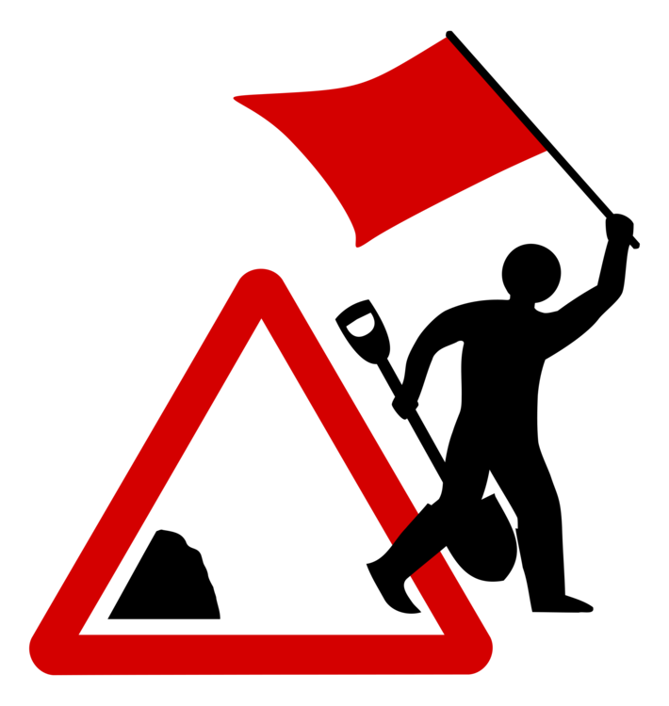
STRIKE!
Definition? Lock out?
How many of you have been involved in a strike?
Tell us about it...

Slide 4
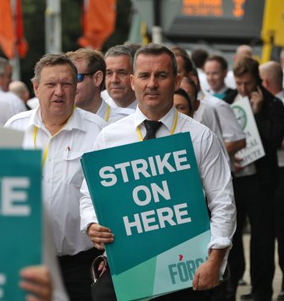
STRIKE
‘a temporary stoppage of work by a group of employees in order to express a grievance or enforce a demand.’
(Griffin, 1939)
Griffin, J.I. (1939) Strikes: A Study in Quantitative Economics. New York: Columbia University Press.

Slide 5
In history...
Historically strikes have been important.
Examples of famous strikes in the Irish context?

Slide 6
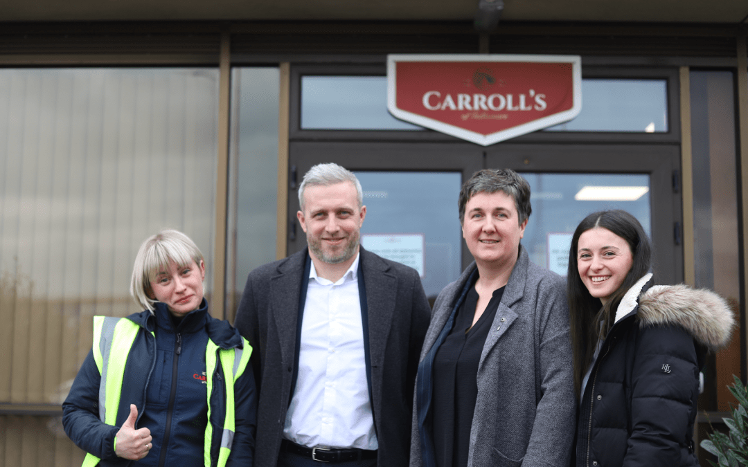
Examples
Carroll’s Cuisine (2025–2026)
The Action: Members at the Tullamore plant engaged in three days of industrial action after management refused to recognize the union or negotiate on pay.
The Result: In February 2026, the strike ended with a double win: management officially signed a Union Recognition Agreement and implemented a new pay structure with "significant increases" for all grades.

Slide 7
Caredoc workers (2025–2026):
Support staff at this out-of-hours GP service (no pay rise in 10 years) balloted and prepared for strike action alongside INMO colleagues. Members voted to accept a pay proposal, ending the dispute successfully through negotiation backed by industrial action threat.

Slide 8
HSE health support staff nationwide (2019)
Over 10,000 SIPTU members, including healthcare assistants, porters, and cleaners, voted 94% for strike action in a job evaluation and pay dispute. After a 24-hour stoppage and threats of further back-to-back strikes, talks at the Workplace Relations Commission led to the suspension of action and an eventual agreement implementing pay adjustments from a 2018 job evaluation review

Slide 9
School Secretaries and Caretakers Campaign (2025)
Fórsa members (school secretaries and caretakers) prepared for and threatened indefinite strike action from late August 2025 after failed talks on pay/conditions (many on low pay or precarious terms). The credible threat led to intensified negotiations with the Department of Education at the WRC, resulting in an agreement after seven days of potential action—delivering pay improvements and better terms through unity and determination.

Slide 10
Northern Ireland Public Sector Strike (January 2024):
this massive one-day strike (involving tens of thousands across unions like NIPSA, Unite, etc.)—billed as NI's largest in 50 years—rallied over pay. It united workers and highlighted demands, contributing to broader pay negotiations and settlements in the public sector.

Slide 11
STRIKE!
Most visible form of industrial action
Not the only form – What other forms are there?
If successful, can strengthen unions’ position
Defeats can lead to decreased union membership and union’s marginalisation

Slide 12
LIST WHY PEOPLE GO ON STRIKE

Slide 13
WAGES
ENGAGEMENT, DISMISSAL OR REDUNDANCY
REORGANISATION, DEMARCATION OR TRANSFERS
Between 2003 and 2011, 22.6 % of strikes where due to wages
29%...
16.1%...
Wallace & Gunnigle et al.

Slide 14
Other reasons:
Union recognition
Pensions
Hours of work
Agreements
Etc…..

Slide 15
Societal Reasons
Economic conditions (“Cyclical explanations”)
Sectoral factors
Political factors?
Others?…..

Slide 16
Trends in Irish Strike Activity
Peak periods: High strike levels in 1960s–1970s (pro-cyclical, rising in economic booms).
Sharp decline since late 1980s/1990s: Lowest levels ever recorded (e.g., all-time low in late 1990s).
Post-2000s: Very low incidence, influenced by social partnership agreements and recessionary caution.
International comparison: Ireland moved from relatively high to very low strike-prone nation.

Slide 17
Irish Trade Union law is based on two separate strands of law:
•Firstly what we ‘inherited’ from the British
•Secondly being legislation post 1922
In Britain and Ireland in the 19th Century Trade Unions were viewed as rebels and revolutionaries or ‘criminal conspiracies in restraint of trade’
A gradual acceptance of the role of unions saw the enactment of legislation to recognise them, namely the Trade Union Act of 1871

Slide 18
Unfortunately while this legalised Unions the courts still went on to find that many of the actions of unions were still illegal –
For instance if two people combined to withdraw labour this was still a common law offence of ‘criminal conspiracy’. Picketing was also held to be illegal.
Of course this frustrated trade unions in their efforts to organise and improve workers conditions

Slide 19
More legislation was passed, but quickly employers found ways of taking cases against the unions or the officials concerned.
Finally The Trade Disputes Act 1906 was passed, which meant that trade unions were : -
Granted immunity from the tort of criminal conspiracy
Legally entitled to picket peacefully
Immune from actions that would otherwise have been illegal under common law

Slide 20
Post 1922 the most significant piece of Irish legislation regarding strikes is the Industrial Relations Act 1990.
In groups, chart requirements for taking legal strike action

Slide 21
The provisions 1990 Act relevant to Industrial Action in this Act are:
One person disputes are no longer immune
•Secondary Action i.e. picketing any other than the employer directly concerned
•Workers may only picket at the employers place of work
(or if this is not practicable, at its approaches)
•Worker v worker disputes are no longer valid trade disputes
•Providing rules for balloting are complied with and notice given, injunctions were to be restricted

Slide 22
•Unions must state provisions for holding ballots in their Rule Book
•Must be a Secret Ballot
•All members who is reasonable to believe will be called on to engage in the strike/industrial action must be balloted
•The union must take ‘reasonable’ steps to ensure that every member entitled to vote votes without interference or constraint and that members have a fair opportunity of voting

Slide 23
•Union’s NEC has authority in sanctioning or supporting a strike or other industrial action notwithstanding that the majority of those voting (including an aggregate ballot) support strike action
•In the case of aggregate votes with other unions action must also be sanctioned by ICTU
•Unions must make known to members as soon as possible after a ballot.
The total electorate, total votes cast, total valid poll, number in favour and against, spoiled votes.

Slide 24
•The Code of Practice on Dispute Procedures (issued by the WRC/Labour Relations Commission) strongly recommends that parties exhaust internal negotiations and refer unresolved disputes to the WRC for conciliation before industrial action. It states that strikes should only occur "after all dispute procedures have been fully utilised."

Slide 25
Clear that nature of the political system and collective bargaining arrangements have an effect on the nature and impact of strikes…

Slide 26
There has been a dramatic decrease in days lost to strike action since the early 1980s
Good?
Neither?
Bad?
Why?

Slide 27
Further Reading
OECD: Collective bargaining in a changing world of work - https://www.oecd-ilibrary.org/sites/empl_outlook-2017-8-en/index.html?itemId=/content/component/empl_outlook-2017-8-en
Chapter 10 of Industrial Relations in Ireland

Slide 28
THANKS

