Slide 1
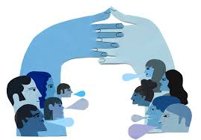
Week 4: Negotiation Workshop
Based of the work of Dr. Gareth Murphy (FSU) with thanks

Slide 2
What is a negotiation?
We are all negotiators
What every day situations do we negotiate?

Slide 3
A definition – Fisher and Ury
Negotiation is a basic means of getting what you want from others. It is a back and forth communication designed to reach an agreement when you and the other side have some interests that shared and others that are opposed.

Slide 4
A definition - Cohen
A negotiation is more than an exchange of material objects it is a way of acting and behaving that can develop understanding, belief, acceptance, respect, and trust. It is the manner of your approach, the tone of your voice, the attitude you convey, the methods you use and the concern you exhibit for the other side's feelings and needs.

Slide 5
Definition – Lewicki et al
For most people, bargaining and negotiation mean the same thing; however, we will be quite distinctive in the way we use the two words. We will use the term bargaining to describe the competitive, win-lose situations such as haggling over the price of an item at a yard sale … we will use the term negotiation to refer to win-win situations such as those that occur when parties are trying to find a mutually acceptable solution to a complex conflict.

Slide 6
Definition – Malhotra and Bazerman
The goal is not to overwhelm the other party with demands, but to give them a lot of different ways to compensate you and make you happy.

Slide 7
Key charachteristics
2 or more parties
Conflict of needs and desires
Choice to negotiate rather than fight/capitulate
Expectation of give and take
Tangibles (issues) and intangibles (people and feelings)

Slide 8
The types we hear about
Win-Lose / Distributive / Competitive
Win-Win / Integrative / Collaborative
Harvard ‘Principled Negotiations’
Kremlin School of Negotiation
Chinese 36 Strategems

Slide 9
Principled negotiations – Harvard Model
People: separate the people from the problem
Interests: focus on interests, not positions
Options: Invent multiple options looking for mutual gains before deciding what to do
Criteria: Insist that the result be based on some objective standard
This approach is solving a problem together.

Slide 10
Negotiating is a process not an event
Not a one-off event
Process
Relationships
Preparation
The communication/bargaining moments (‘the negotiations’)
The after is just as important
There will be a next time

Slide 11
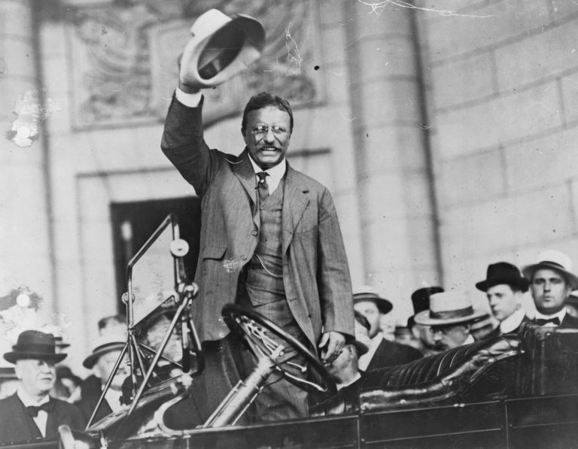
A classic example – Roosevelt Campaign
Roosevelt Campaign 1912
3 million leaflets printed with photo
Permission for photo not sought
Photographer would be entitled to $1 per photo
$3 million in 1912 is $100 million in today’s terms
Reprinting costly and lead to serious delays
Looked like campaign manager would have to negotiate
with the photographer

Slide 12
The Campaign Manager’s Strategy
“Planning to distribute three million copies of campaign speech with photographs. Excellent publicity opportunity for photographers. How much are you willing to pay to use your photographs? Please respond”

Slide 13
The Photographer’s Response
“Planning to distribute three million copies of campaign speech with photographs. Excellent publicity opportunity for photographers. How much are you willing to pay to use your photographs? Please respond”
“Appreciate opportunity but can only afford $250”.

Slide 14
Key Lesson
Brilliance of campaign manager was he did not focus on his own bargaining strength but the other side’s – the photographer
Campaign managers position was very bad – reprint or pay a lot of money to the photographer
But he realised that photographers alternatives not great either – lose publicity opportunity and make no money at all

Slide 15
3 elements of negotiations - Cohen
Information – know your needs and know their needs
Time – time constraints and deadlines
Power – creating power

Slide 16
Theoretical perspectives on work
Unitarist
  Shared goals
  Harmonious relations
  Conflict is abnormal
  Management prerogative
Pluralist
  Numerous groups
  Varying interests
  Focus on managing conflict
Critical (class, gender, race)
  Power dynamics
  Control and exploitation
  Conflict inherent

Slide 17
And negotiations?
How you view relations at work will shape your approach to negotiations in the workplace

Slide 18
What situations are you likely to face?
Hiring and firing
Pay
New policies
Regulatory demands
Unions, EWCs, Pension Trustees...
Challenging employees/managers
And more??

Slide 19
Let’s try out the perspectives on the situations
Pay bargaining with a union
  Unitarist
  Pluralist
  Marxist
Return to office
  Unitarist
  Pluralist
  Marxist
How do the different perspectives see these situations
How will that influence how they approach them

Slide 20
Win-Lose and Win-Win
Distributive
Integrative
BATNA - best
WATNA – worst
ZOPA - zone
Opening offers – anchoring
Ackerman concessions
Closing options
  Split the difference
  Exploding offers (deadline)
Define the problem
Free flow of information
Understand each others need
Things in common
Search for solutions together
Create value and options
Nothing agreed until everything

Slide 21
Consider this
The conclusion to be reached is that normally a desire for integrative problem solving will only exist if both parties wish to pursue an integrative process. This condition is unlikely unless both parties perceive a potential for an integrative solution and a forthcoming integrative response from the other party. Given a history of distributive bargaining such perceptions are unlikely. – Coleman and Fraser

Slide 22
Tactical empathy – Voss and Raz
If the other side not willing to problem solve (too emotional)
Emotional intelligence becomes central
Tactical empathy
  Listen
  Gain rapport and trust
  Elicit the real issue
  Affirm relationship

Slide 23
Ackerman Bargaining
For very specific numeric bargaining
Set your number
Offer 65%
Biggest move to 85%
Smaller move to 95%
Smallest move to 100%
Make that last number very specific
What’s the thinking behind this model?

Slide 24
When an ultimatum can work - Cohen
Frosting on the cake: the other side must have no other choice or they must have such an investment that they can't fold their cards and walk away therefore an ultimatum must come at the end of a negotiation
Soft and palatable: the words use must never belittle or offend the other side soft ultimatums are palatable because they're simply a statement of your reality
A recipe that can't be tampered with: it's always wise to back up your final position with some form of documentation or legitimacy
Selection from a limited menu: never leave the other side without alternatives rather structure the situation to allow them to make the choice with one option always much more desirable to them

Slide 25
Union Management Integrative or Distributive
What have we always done
What will the other side do
What do our constituents expect
Will an integrative approach weaken my side

Slide 26

Most negotiations
A combination of both
Often integrative overall
But distributive at particular points
Need to understand and apply both

