Slide 1
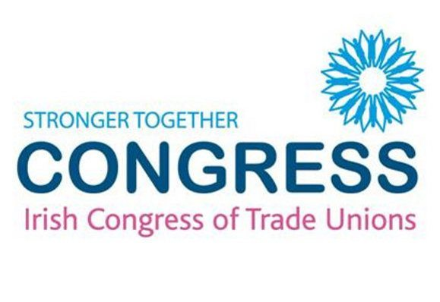

Trade Unions and
Collective Bargaining
Week 1
Dan O’ Neill – SIPTU College Learning Coordinator

Slide 2

What would you hope to cover in a module called
“Trade Unions and Collective Bargaining”

Slide 3
What we will look at in this lesson:
This lesson introduces 'collective bargaining'; what it is; where it evolves from; who is involved generally trade unions, employers and the State.
Collective bargaining, as with the entire subject of industrial relations, is viewed differently by people depending on their view of the world.

Slide 4
Some definitions?

Slide 5
What are trade unions?

Slide 6
Defn: Industrial Relations?

Slide 7
Industrial relations encompasses a set of phenomena, both inside and outside the workplace, concerned with determining and regulating the employment relationship.
(Salamon 2000)

Slide 8

Defn: Collective Bargaining?

Slide 9

Negotiation of wages and other conditions of employment by an organised body of employees. (OED)

Slide 10
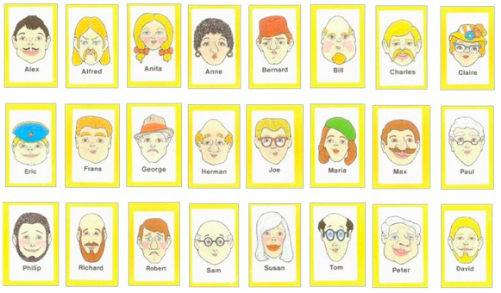
Guess who/what?
IBEC
Karl Marx?
John Maynard Keynes?
Laissez-faire
Monetarism

Slide 12
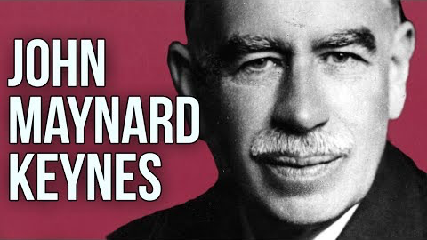

Slide 13
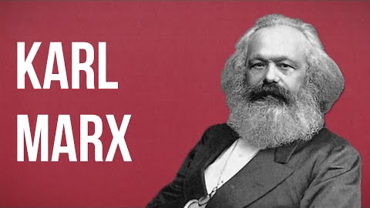

Slide 14
Laissez Faire
A ‘hands-off’ approach
The driving principle behind laissez-faire, a French term that translates as "leave alone" (literally, "let you do"), is that the less the government is involved in the economy, the better off business will be – and by extension, society as a whole.

Slide 15
Monetarism
Monetarism today is mainly associated with the work of Milton Friedman.
A central bank policy aimed at keeping the growth of the money supply at a rate commensurate with the growth in productivity and demand for goods.
It argues that excessive expansion of the money supply is inherently inflationary, and that monetary authorities should focus solely on maintaining price stability.

Slide 16
Who’s Who in IR?
Industrial relations is not just about trade unions.
Institutions:
  Trade unions, third parties, employer organisations, educational and research bodies
Role players:
  Shop stewards, full-time trade union officials, HR managers and officers and third-party actors.
Processes/Procedures:
  Third-party referrals, strikes and union recognition.
Issues:
  Role of the state, European Commission, etc.
  Role of collective and individual labour law, politics

Slide 17
Model of the Irish system of industrial relations
Unitary perspective
Pluralist perspective
Marxist perspective
Contextual influences
Historic • International • Economic • Labour market • Technological • Political • Legal • Social • Media
Third-party institutions
National level
Bargaining – Consultation
Trade unions
Organisation level
Sectoral/industrial level
Bargaining – Consultation
Employer associations
Conflict = Co-operation
Unionised
Representation
Non-union
= Collective bargaining
= Individual bargaining
= Procedural agreements
= Substantive agreements
= Involvement/participation
Top management
Personnel department
Line management
Systems
perspective
Social action
perspective

Slide 18


History and IR
Eighteenth- and nineteenth-century laissez-faire economic orthodoxy fuelled by advent of Industrial Revolution and growth of factory production
TUs grew – attempt to redress power imbalance
TUs defined as: ‘A continuous association of wage earners for the purpose of maintaining and improving working conditions’ (Sidney and Beatrice Webb)

Slide 19

Initially combinations unlawful and depicted as ‘iniquitous extortions’
Early 1800s emergence of craft unions; in 1880s, trades councils; followed by growth of inter-union co-operation
1871–1906: UK legislation recognised TUs
    Post-Lockout (1913): ITUC almost trebled in membership

Slide 20
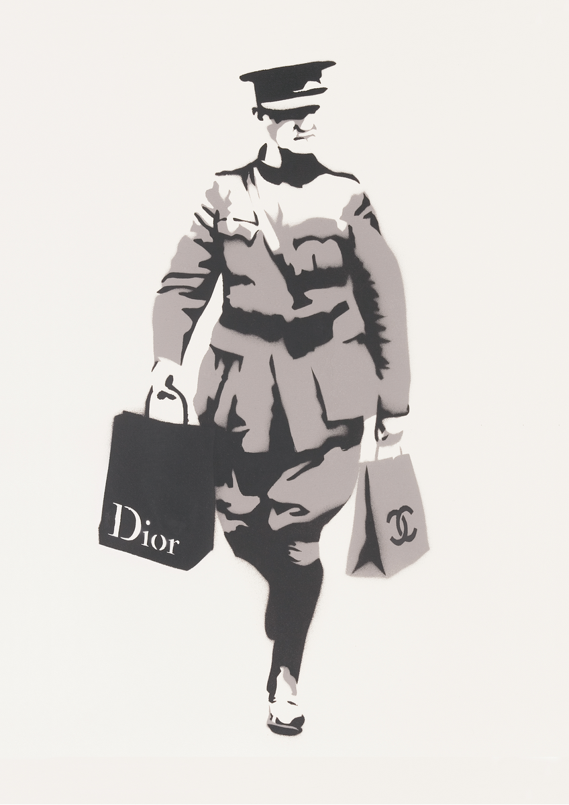
Free State
    New state (post-1922) inherited legal tolerance of TUs
    Industrial policy almost non-existent in new state and TUs surfacing hesitantly
    1930s: advent of protectionist economic policies, agriculture still dominating economic activity, TU focus on wage differentials rather than wider concerns

Slide 21
    1940s and 1950s: after initial tentative recovery, 1950s marked by mass emigration, unemployment; TUs resigned themselves to economic stagnation; 70% increase in strike frequency and TU membership levels in late 1940s
    Late 1950s sees advent of new economic development strategies
    1960s: ‘national adolescence’, TU membership up by 50%, FDI a feature, strike levels escalating
    1970s: Keynesian approach replaces laissez-faire, national pay agreements emerge, unofficial strikes frequent

Slide 22
Economic ‘Realities’ and IR
Role of TUs constantly adapting to political and economic realities
Response of TUs: pragmatic and reactive
1980s: dark period of combined explosive national debt, unemployment, emigration and taxation
Economic response: monetarist, return to neo-liberal economic policy

Slide 23
IR outcome: moderate pay and reduced government spending
Reduced TU bargaining power, falling unionisation, declining welfare benefits, intensification of divisions in society but conservatism remains dominant political orthodoxy
Mid-1990s: advent of the Celtic Tiger, complete reversal of economic fortune, “attributed to social partnership deals.”
Since 1987, social partnership agreements emphasised economic recovery, European integration, and improvement in wages, living standards and social services

Slide 24
Economic ‘Realities’ and IR (continued)
Up to 2000: growth based on sound economy and increased competitiveness
Post-2000: property bubble and increased public spending
2008: recession, housing market in decline, bank guarantee introduced
2010: marked economic contraction, unemployment at 14.7% by end 2010
Croke Park Agreement 2010 –2014: co-operation on public sector pay and pension reforms in exchange for commitment to no redundancies or pay cuts
TUs perceive their role as ‘rubber stamping’ decisions made by employers; labour market exerts significant influence on IR and HRM policies and practices

Slide 26
Politics and IR
State a significant player: TUs move from illegal status to role in neo-corporatist/social partnership
State essentially holds with liberal capitalism tempered by concessions to TUs
Initial grudging adoption of entitlements granted by Britain
Largely supported voluntarist principles, confining legal interference to mediation services
TUs looked to the Labour Party with negligible industrial base and ‘national’ question dominating

Slide 27
Politics and IR (continued)
Working class essentially politically conservative: lack of vibrant left-wing movement and largely centre/centre right dominance
Up to 1970s: state’s auxiliary role avoided direct coercive interference in IR process, so free collective bargaining commonplace; during 1970s, national understandings emerge
Gradual creation of welfare state, provision of public service and maintenance of semi-states upheld political consensus
From 1960s: merging interventionist ideology in evidence with TUs invited onto National Industrial and Economic Council
Tripartite consultations key to economic adaptation, restructuring and establishment of planning targets

Slide 28
Politics and IR (continued)
Downgrading of enterprise and sector-wide collective bargaining, along with national-level tripartite bargaining, marked a new phase in the relationship between state and TU movement
EEC (1973): affected industrial development and individual labour law, influx of MNCs sees new HRM practices, non-union establishments
1980s: hardened negotiating stance on the part of the state and employers;1987 onwards sees social partnership re-emerge but against a backdrop of declining TU membership and rising unemployment

Slide 29
Politics and IR (continued)
1990s: persistent recession and EU constraints heralded a new era in IR
Resurgence of neo-liberalism, individualism and demise of Eastern bloc shook left-wing and TU ideology and reinforced TU involvement in neo-corporatist model
Since 1990s: quid pro quo for industrial peace was involvement in partnership
Social partnership seen by some as key to the (short-lived) economic miracle that was the Celtic Tiger
Some dispute this – social partnership is the whipping boy for excess state spending; however, a new form of governance sees post-Celtic Tiger shift from social partnership to social dialogue

Slide 30
THEORETICAL PERSPECTIVES AND IR
1. Pluralist Analysis
Post-capitalist society: society comprises a range of individual players with individual objectives
Political system is institutionalised and regulated through parties and parliamentary processes, so too is the industrial system
Competing organisational values and interests have to be managed to maintain collaborative structure
Conflict is a logical and inevitable feature of the world of work, requiring management by a variety of players

Slide 31
Pluralist Analysis (continued)
Marxist analysis is outdated with advent of franchise, rights, public services, etc.
Industrial and political conflict are separate; collective bargaining regulates relations with an array of third-party institutions providing resolution of conflict
Institutions include:
  TU and employer associations
  Social partnership
  LRC and Labour Court
  Shop stewards and employee reps
  Consultation initiatives for workers

Slide 32
2. Unitary Analysis – Managerialist
Workplaces share goals, values and interests
No conflict between owners and employees
Strong management and common goals of increased profitability => organisational effectiveness
Paternalism, rejection of unions and/or minimal concern for employee welfare
Conflict not perceived as a structural feature of organisational life
Common in Ireland with increased levels of opposition to TU recognition and associated rise in the number of non-union establishments

Slide 33
3. Radical/Class Conflict Analysis
Marxist theory: analysis of evolution of society; rampant capitalism is a ‘stage’ driving an ever-growing, impoverished working class towards inevitable revolutionary change
Class conflict is at the root of societal change, arising from inequitable distribution of power and wealth in wider society
IR system viewed as a marginal forum for the conduct of class war
Collective bargaining seen as facilitating the inherent contradictions of capitalism

Slide 34
Radical/Class Conflict Analysis (continued)
As a theoretical perspective , Marxist analysis focused on relative power of opposing interests and offers valuable insights into mechanics of the IR system
Conflict in IR arena seen as a reflection of opposing economic interests engendered by capitalism:
  Conflicts are contained by the social and political system and the trade-offs made to ensure its stability
  Institutions of IR serve to institutionalise conflict
  Looks at ‘root’ sources and causes of conflict, not just its resolution

Slide 35
4. Social Action Analysis
Emphasises individuals’ freedom of action and ability to influence events
IR actions best understood in terms of their subjectively intended meanings
Actions not solely influenced by specific work situations but also by:
  Attitudes, values and expectations
Role of Jim Larkin – a social action effect?
Individuals have the ability to influence and shape events
“Society makes man…man makes society.” (Silverman 1970)

Slide 36
5. Systems Analysis
Arose from a desire for an integrated approach to the study of IR
Prior to this, IR had been studied from the perspectives of differing disciplines
John Dunlop, 1958 – system approach
  Attempt to create a focused and integrated approach to the subject
  System with four parts: actors, environment, rules and ideology

Slide 37
Systems Analysis (continued)
Actors
  Managers and their reps – supervisors
  Employees and their reps – unions
  Government and third parties – Labour Court, etc.
Environment
  Technology
  Budget constraints
  Power in wider society
Rules
Ideology
  Underlying belief system: voluntarism

Slide 38
Critical Comments on Differing Approaches
Pluralist/Unitary approach:
  Influential but subsequently modified (see later chapters)
Marxist approach:
  Enjoyed a resurgence in 1960s/1970s
  Predictions have not materialised
Radical approach:
  Strong on analysis rather than developing practical solutions

Slide 39
Critical Comments (continued)
Systems theory
  More an organising device than a theory
  Conservative, since it gives limited recognition of the role of conflict
Social Action
  Recognises a role for individual action/meaning
  May underestimate the extent to which actors are the prisoners of systems factors

Slide 40
Rules
Found in all IR systems
Sources of rules
  Unilateral: management, labour, government
  Joint: agreed procedures
  Custom and practice
  Third parties
  The law
    Common law, legislation, constitution and international law

Slide 41
Conclusion
IR is not simply a descriptive subject based on common sense, a single analytical framework or a set of incontrovertible facts and statistics
Political and theoretical controversy inherent in the topic of IR
Variety of ways of interpreting what is going on, multitude of opinions about what should be happening in this subject area
No universally accepted global theory

Slide 42

bit.ly/irchapter1

Slide 43
Next week…
We will be looking at trade unions
I want everyone to know the basic structure of their union (how decisions are made) and a brief history (when it was founded etc. )
I will tell you more about how the course is going to be marked in terms of assignments etc.

